Slide 1
Structural variation of 30,659 bipolar and schizophrenia patients identifies novel genetic insights
Robert Ye
On behalf of the Whole Genome Sequencing for Psychiatric Disorders Consortium (WGSPD)
Neale and Talkowski Labs
Notes:
Good afternoon, today I'll be talking about how structural variation from the largest deep whole genome sequencing cohort of bipolar and schizophrenia patients can help us identify novel genetic insights.

Slide 2
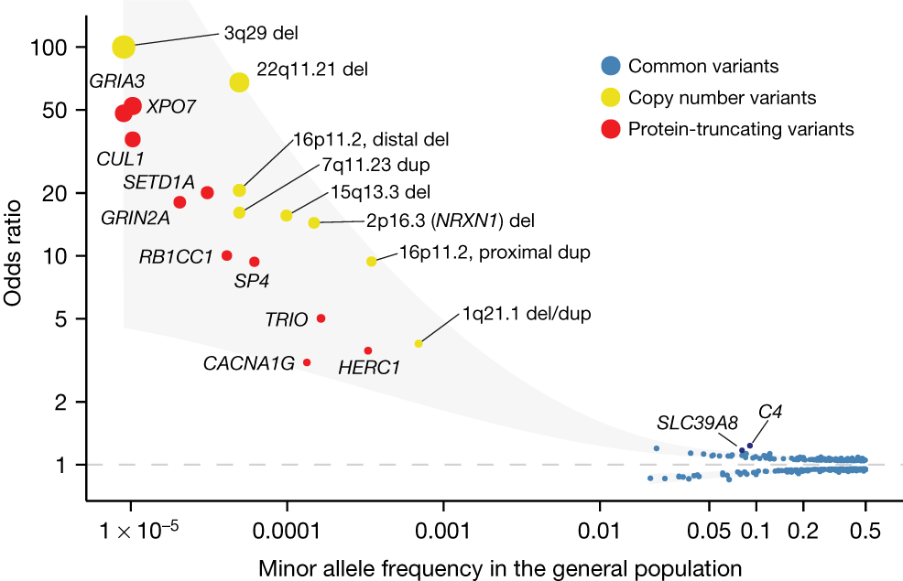
Rare coding variation is enriched in schizophrenia cases
Singh et al. (2022) Nature
Notes:
I’d like to start by highlighting the informative role that rare genetic variation has played in gene discovery for neuropsychiatric diseases. It’s been previously shown in the Bipex and SCHEMA exome studies that the rarest coding variation often confers the greatest risk for disease.
For example, in this plot from the SCHEMA analysis, we can see that as we consider rarer events along the allele frequency spectrum (towards the left side of the plot), it’s the rarest copy number and rarest protein-truncating variation that have the largest effect sizes in schizophrenia cases.
Again, these results were produced from an exome-based analysis and naturally leads to the question of…
Top genes associated with things such as transcriptional regulation, nuclear transport, and ion transport.
90% of disease associated GWAS loci discovered by assaying common variants map to noncoding regions
In humans, >4% of noncoding genome has been under purifying selection
Epigenomic studies have identified many functional noncoding elements involved in regulating gene expression underlying neurogenesis, cell differentiation, and neurodevelopment.

Slide 3
Rare coding variation is enriched in schizophrenia cases
What more can we learn from whole genome sequencing?
Singh et al. (2022) Nature
Notes:
Well, how much more could be out there if we were to just broaden the scope of our analysis to include the whole genome? Namely, through whole genome sequencing

Slide 4
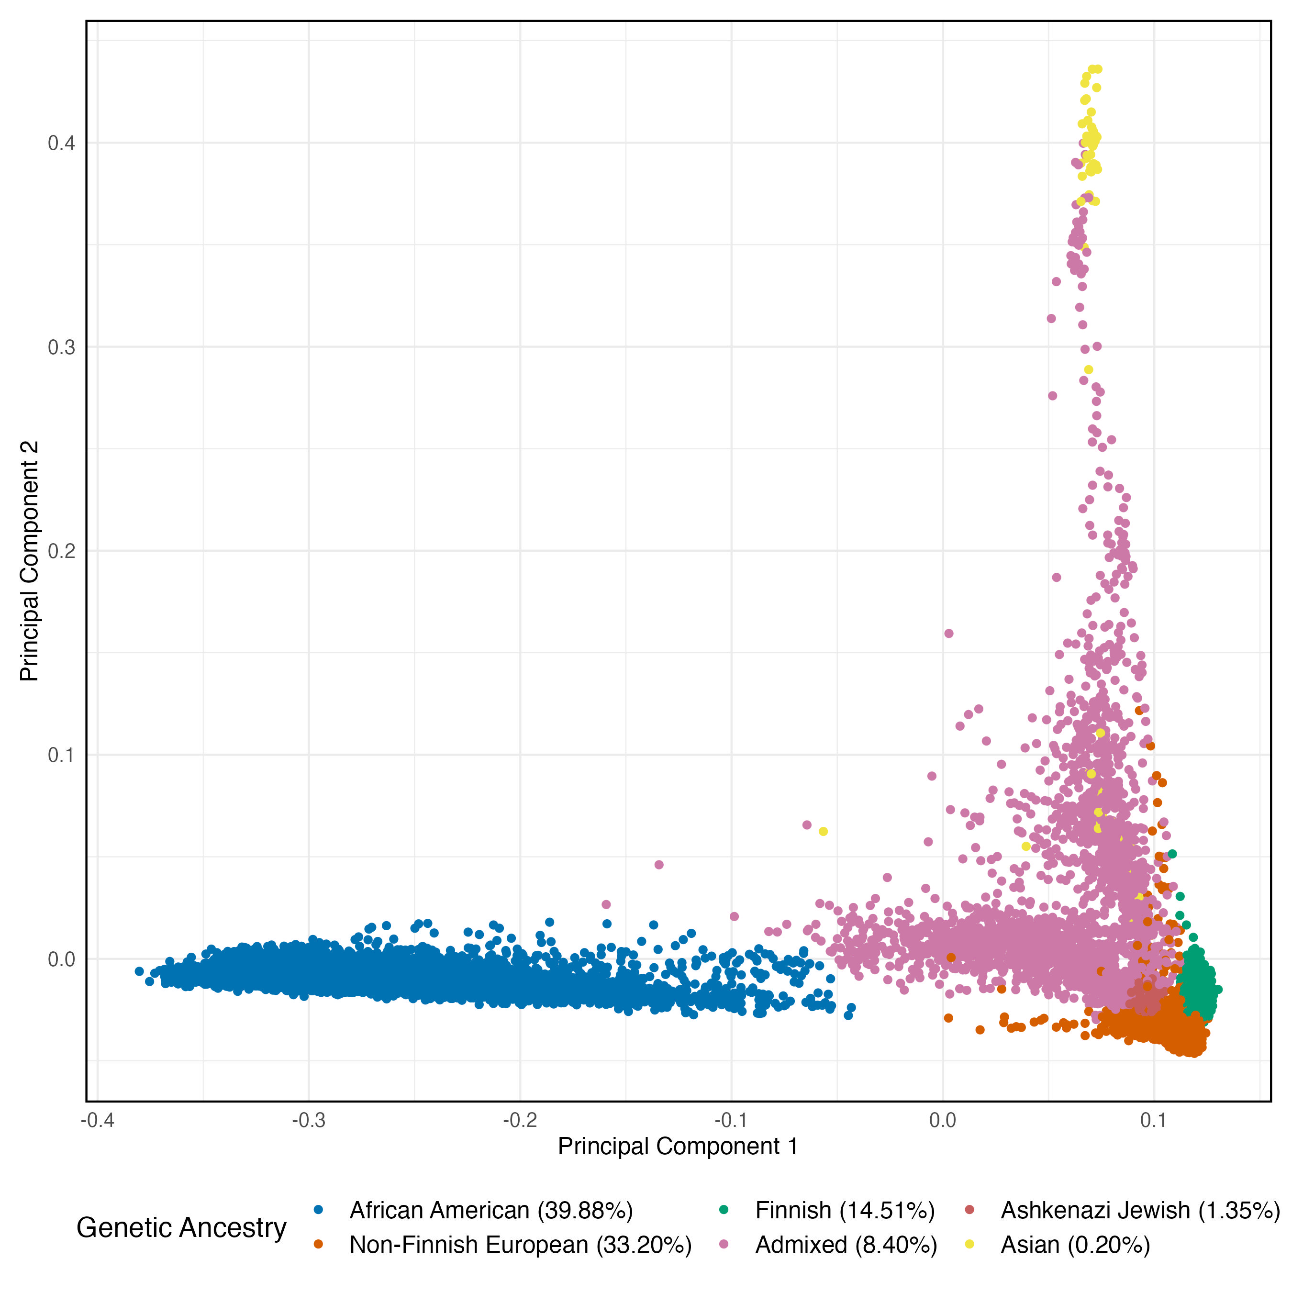
WGSPD
Schizophrenia (7,224)
Bipolar Disorder (2,358)
Controls (23,664)
Notes:
And this is where the WGSPD consortium sits perfectly to start chipping away at this question
Importantly, these whole-genome sequenced samples offer better detection for single nucleotide variation, as well as for larger structural variation events, across a much larger scope of the human genome compared to WES.
For today, we’ll be focusing on the bipolar and schizophrenia subsets of the cohort
In total, this analysis includes ~9500 cases and ~23.5k controls from a US based population.
I’ll note that for all of the following analyses, the BP and SCZ samples were aggregated and analyzed together due to the known genetic overlap of the two conditions.
Some overlap with SCHEMA1 samples
30x WGS coverage
Post sample qc (filtering out poorly genotyped samples, related samples, samples with mismatching reported and imputed sex records, and samples with mismatching reported and inferred ancestry records)
For some background, the WGSPD consortium is a partnership between the National Institute of Mental Health, the Stanley Center for Psychiatric Research, as well as 11 academic institutions.

Slide 5
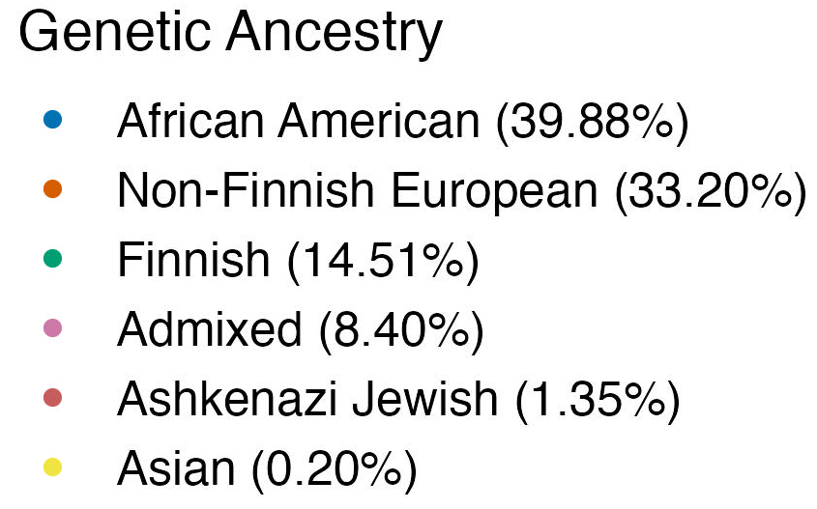
Notes:
It’s also worth highlighting that the incredible diversity of this data (particularly the African American individuals) gives us the opportunity to analyze genetic ancestry groups that have been historically underrepresented in the psychgen space.
Some overlap with SCHEMA1 samples
30x WGS coverage
Post sample qc (filtering out poorly genotyped samples, related samples, samples with mismatching reported and imputed sex records, and samples with mismatching reported and inferred ancestry records)
For some background, the WGSPD consortium is a partnership between the National Institute of Mental Health, the Stanley Center for Psychiatric Research, as well as 11 academic institutions.

Slide 6
Gene sets in our analyses
Gene set | # genes | Source
Schizophrenia | 32 | Singh et al. (2022) Nature
Autism Spectrum Disorder | 72 | Fu et al. (2022) Nat Genet
Neurodevelopmental Disorder | 373 | Fu et al. (2022) Nat Genet
Constrained Genes | 3570 | Karczewski et al. (2020) Nature
Notes:
So, in order to make our results a little bit more digestible later, here are the gene sets that we used to frame our analysis, all validated in separate studies.
The schizophrenia, autism spectrum, and neurodevelopmental disorder gene sets that we’ll show were all derived from various meta analyses of large exome consortiums.
And the constrained gene set is a set of genes that were previously identified to be under strong purifying natural selection (or constraint).
For each of these gene sets, we look at rare variation enrichment in cases compared to controls.
pLI (gnomad probability of being loss of function intolerant) metric > .9 [identified from the analysis of ~60k exomes (gnomAD)]
Bonferroni FDR significant genes [from ~24k schizophrenia cases and ~97k controls (SCHEMA)]
Bonferroni FDR significant genes [63k exomes spanning 33 autism cohort]
For each of these, we conduct a fishers exact test comparing ultra-rare counts between case and controls to arrive at an odds ratio estimate. We defined ultra rare as a MAC < 10, which corresponds to a MAF of < ~1/10

Slide 7
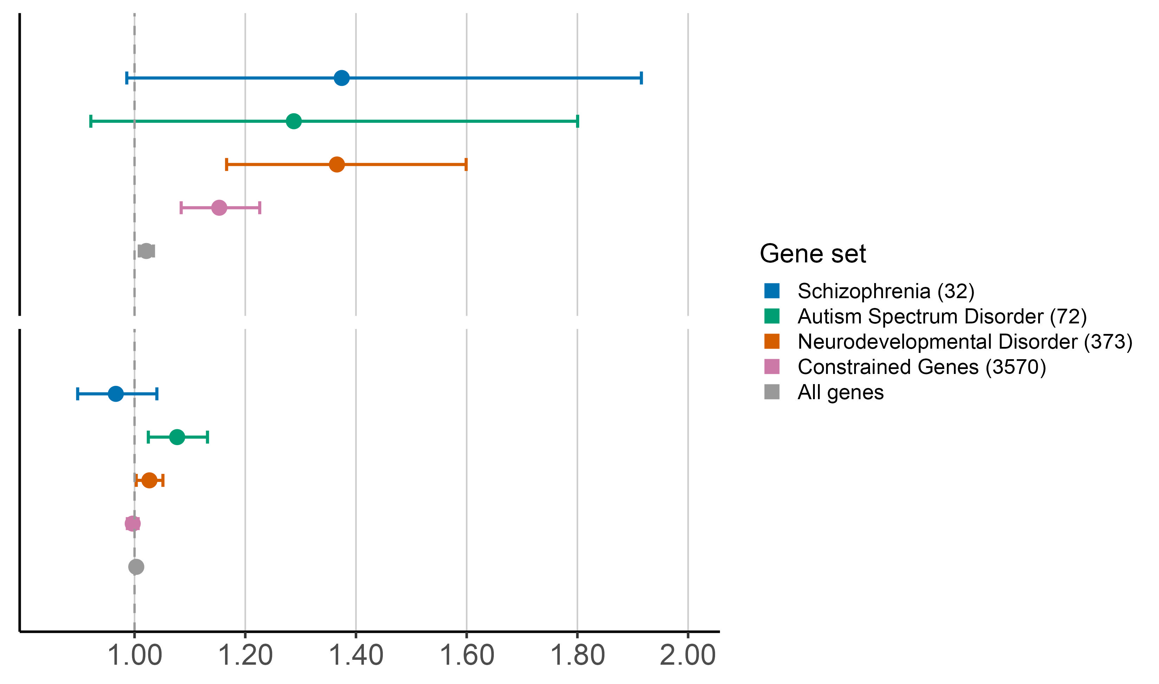
Coding SNVs
Protein
Truncating
Variants
(PTVs)
There is an expected enrichment of rare protein truncating variants (PTVs) in constrained and neuropsychiatric genes
Odds ratio (95% CI)
Notes:
The first thing that we looked at were rare coding single nucleotide variants (SNVs).
And what we saw was an expected enrichment across the board of rare protein truncating variants (or PTVs) within each of our gene sets of interest.
Stepping through each of the results,
On the right, we’re plotting odds ratio estimates and corresponding 95% confidence intervals
Going one-by-one, we see a positive effect in genes associated with schizophrenia (in blue) with an OR estimate of about 1.4.
(And this larger effect, compared to the other gene sets, is somewhat expected, due to the composition of our cohort)
Next, the autism (in green) and neurodevelopmental (in orange) gene sets also show a similar effect likely due to the genetic overlap between these conditions and our cohort phenotypes.
We can also see an enrichment of PTVs disrupting genes that are under constraint (in pink), with an OR estimate of 1.15.
Lastly, we’ve also included an additional baseline metric that looks at all genes that were detected (in grey), and this is expected to be something close to 1, which is exactly what we see.
All together, these results serve as a really great and encouraging positive control, since we’re reaffirming that we can detect the same sort of effects through genome analysis as we’ve seen before in exome analysis.
PTVs predicted using ensemble’s variant effect predictor VEP

Slide 8
Coding SNVs
Protein
Truncating
Variants
(PTVs)
There is an expected lack of enrichment of rare synonymous variation in constrained and neuropsychiatric genes
Odds ratio (95% CI)
Synonymous
Variants
Odds ratio (95% CI)
Notes:
Next, we took a similar look at rare synonymous variation with respect to these gene sets as a sort of negative control
This time, we’re seeing almost no enrichment with all of our OR estimates hovering at around 1 and this is all within reason for our expectations.
After all, synonymous variation isn’t expected to have much effect (if any) on gene expression, so it wouldn’t make sense to see any significant enrichment like we do for PTVs.

Slide 9
Coding SNVs
Protein
Truncating
Variants
(PTVs)
There is an expected lack of enrichment of rare synonymous variants in constrained and neuropsychiatric genes
What about noncoding regions?
Odds ratio (95% CI)
Synonymous
Variants
Odds ratio (95% CI)
Notes:
And so now that we have confirmation that we’re well established and well calibrated for signal in the coding regions, we can turn our attention to the noncoding regions that, once again, we haven’t been able to interrogate as well using just whole exome sequencing.

Slide 10
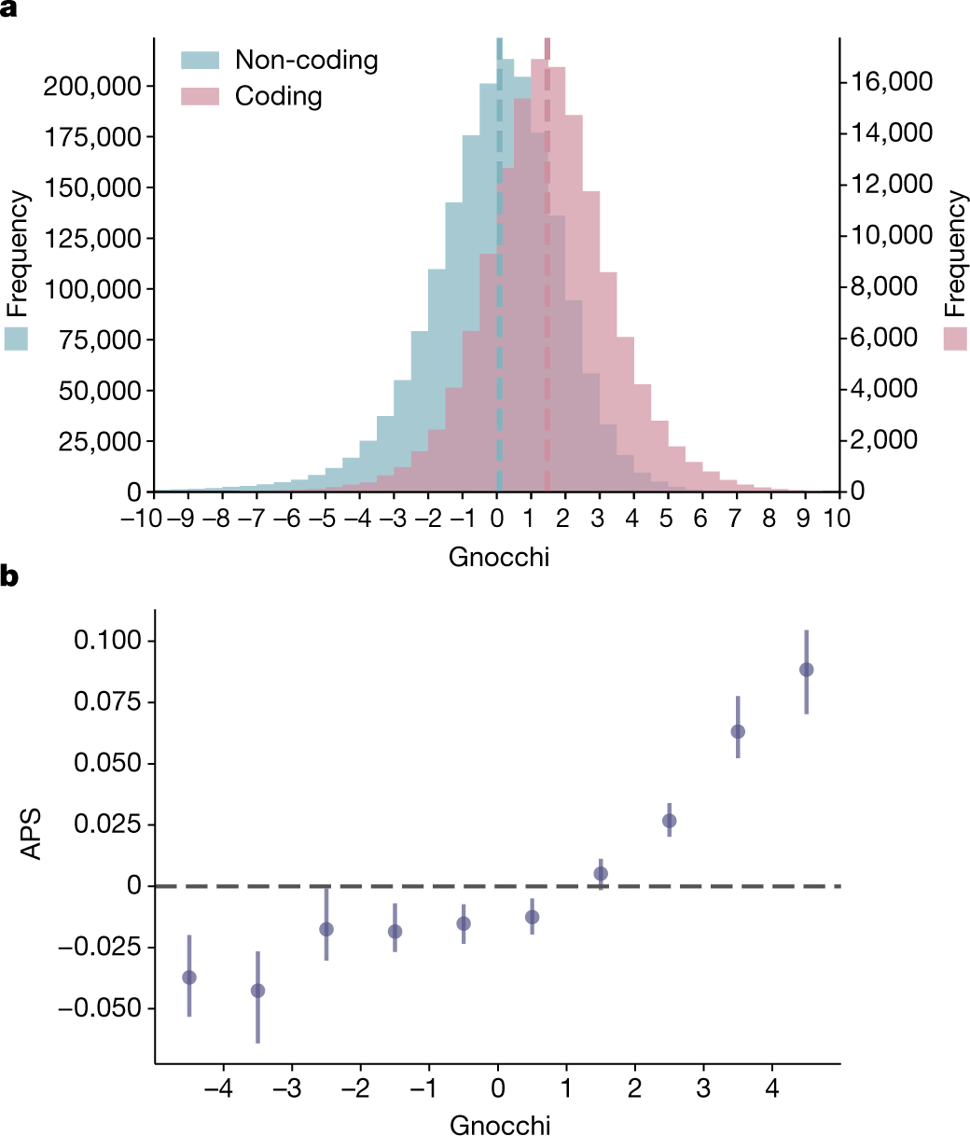
Noncoding constraint focuses the scope of our analysis
Chen et al. (2024)
Notes:
Similar to the previous notion of constraint in coding regions, what we’re about to use here is a new metric called Gnocchi that similarly quantifies constraint in noncoding regions (summarized by the distribution in blue)
And what’s really neat about this is that it lets us start to ask similar questions about the noncoding space as we have been able to with the coding.
Specifically, what we’re going to be interested in looking at are the most constrained, most informative noncoding regions to see what kind of signal we can start picking up on among cases and controls.
1kb windows
through which we can identify protein-coding genes that are under purifying natural selection,
And the general idea here is that, while we have a nicely annotated “roadmap” (in a sense) for the coding regions, right now the noncoding space

Slide 11
Noncoding constraint focuses the scope of our analysis
Chen et al. (2024)
Notes:
These highly constrained noncoding regions fall around here, and correspond to about the 99th percentile of constraint.
1kb windows
through which we can identify protein-coding genes that are under purifying natural selection,
And the general idea here is that, while we have a nicely annotated “roadmap” (in a sense) for the coding regions, right now the noncoding space

Slide 12
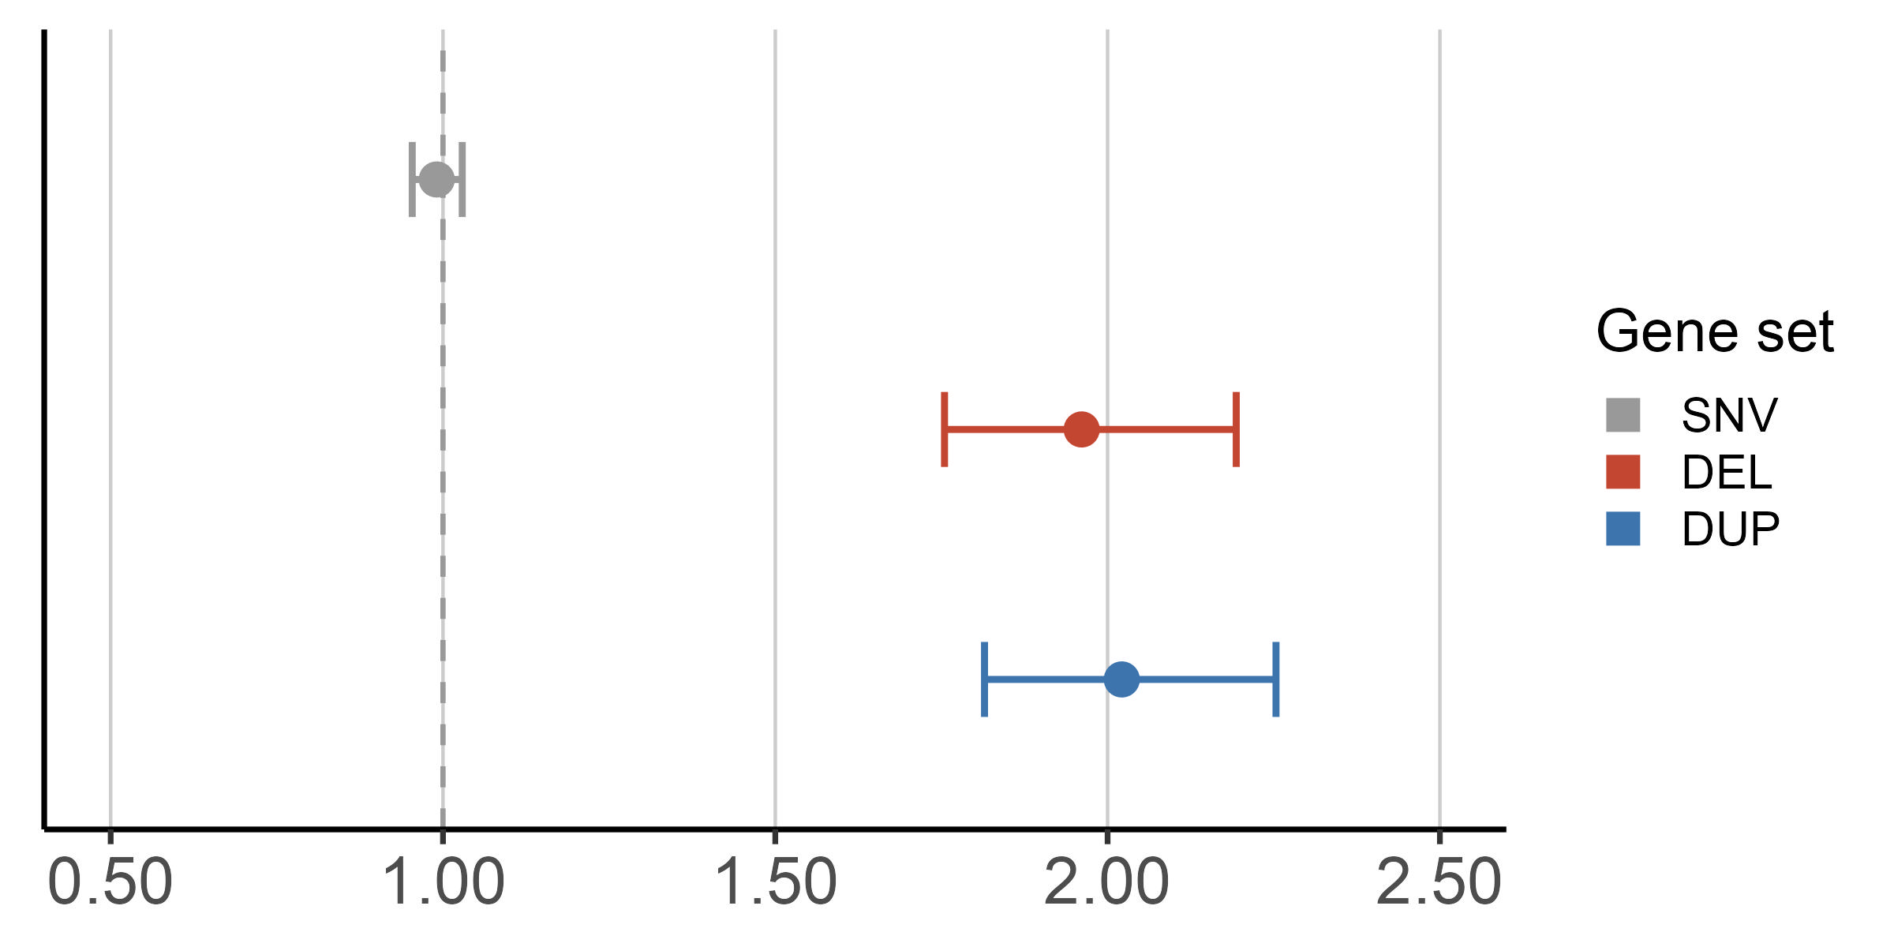
Noncoding Constrained Regions
Noncoding
SNV
There is no significant enrichment of rare single nucleotide variation (SNV) in noncoding constrained regions…
Odds ratio (95% CI)
Notes:
Unfortunately this time, we don’t find any significant positive enrichment of rare noncoding SNVs. With an odds ratio of around 1

Slide 13
Noncoding Constrained Regions
However, there is a significant enrichment of rare deletion and duplication structural variation (SV) in noncoding constrained regions
Noncoding
SNV
Deletion
SV
Duplication
SV
Odds ratio (95% CI)
Notes:
And while SNVs haven’t shown themselves to be the best window into the noncoding regions, (and I’m about to give away my real punchline here and where we’re going) there’s a stark difference when we look at rare structural variation (SVs) using the same set of noncoding constrained regions.
Specifically, there’s a strong positive enrichment in our cases when we look at large deletion and duplication events spanning these constrained noncoding intervals.
Rather than just point mutations within these intervals.
And again, these are the 99th percentile of constrained regions and we can see that the odds ratios of these two events are much higher compared to the weaker effect that we see in noncoding SNVs.
And before we move on, I really want to emphasize this comparison and once again bring attention to this difference that we’re seeing. Unlike in the coding space, the effects of single nucleotide events are much harder to characterize in noncoding regions. On the other hand, larger structural perturbations (like these deletions spanning entire regions) could be more informative and provide greater insight, despite generally being more rare.
Afterall, how do you differentiate a “synonymous-like” and a “protein-truncating-like” point mutation in the noncoding space? Before, we were able to accurately throw out synonymous variation from our analysis and saw an expected enrichment signal within our cases. But there’s no notion of that in the noncoding space yet, so we would have to rely on much larger cohort sizes.
Filtered to 19471 intervals (1kb in size each), z >4 corresponding to ~99th percentile of all noncoding 1kb intervals
Bc we don’t know what’s happening in snvs, harder to id signal (can’t remove synonymous-like SNVs, or SNVs that don’t result in any change of expression)
In coding region, we can partition into ptv, mis, syn

Slide 14
Noncoding Constrained Regions
However, there is a significant enrichment of rare deletion and duplication structural variation (SV) in noncoding constrained regions
Noncoding
SNV
Let’s focus on structural variation instead
Deletion
SV
Duplication
SV
Odds ratio (95% CI)
Notes:
And this is the basic rationale for why we expanded our analysis beyond just single nucleotide variation. And instead shifted our focus and started to consider structural variation in this next section.

Slide 15
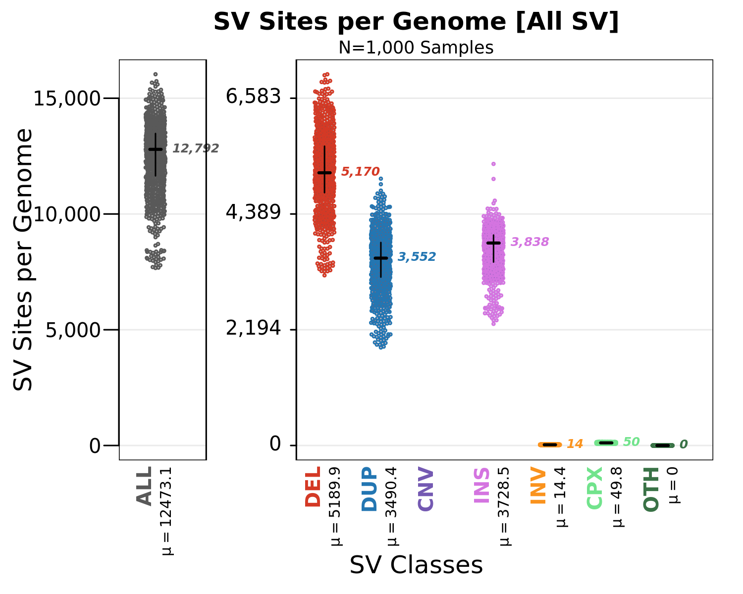
Deletion events are well-characterized in WGSPD
Notes:
But before diving into the analysis, some housekeeping.
First, here’s a summary of the quantity of SV events being called per sample in our cohort.
We can see that, overall, the resolution that we have from WGS is generally much higher compared to what we can get out of microarrays, with over 10k events per individual
However it is important to note that the events that we’re calling are still relatively rare in the grand scheme of things, particularly when we further break down into different SV classes and subcategorizations.
The advantages of resolution and scope that comes with WGS compared to WES naturally lend themselves well to characterizing Structural variation (SVs) across the genome in both coding and noncoding regions.
Not only that, whereas WES is only able to capture copy number variants (or CNVs), which include DEL, DUP, and MCNVs, WGS is able to capture other SVs in addition to CNVs. To include insertions, inversion, translocations, and other complex SV.
Together, this allows WGS to detect 10,000 times more SVs per genome than with WES

Slide 16
Deletion events are well-characterized in WGSPD
Notes:
And on that note, here is a further breakdown of the events by SV class
While we do seem to have a very high number of duplication and insertion events per sample, their interpretability is much more annotation dependent
Also look into insertion events such as with ALU, L1, and SVA mobile element insertion events

Slide 17
Deletion events are well-characterized in WGSPD
Notes:
Moving forward, our analysis for now will focus on deletion events because of, first, their relative abundance and, second, more importantly, their more straightforward interpretability compared to duplication and insertion events, which are much more annotation dependent
While we do seem to have a very high number of duplication and insertion events per sample, their interpretability is much more annotation dependent

Slide 18
Our deletion class of interest
Promoter
Exon 1
Intron
Exon 2
Intron
Exon 3
Intron
Exon 4
5’ UTR
CDS
Notes:
So the final order of business is the types of deletion classes in our analysis
Here’s a simple cartoon that I’ll use to help illustrate what exactly each of our class definitions entails
(a breakpoint in an exon)

Slide 19
Our deletion class of interest
Exonic
Deletion
Promoter
Exon 1
Intron
Exon 2
Intron
Exon 3
Intron
Exon 4
5’ UTR
CDS
Notes:
The first class that I’ll show is exonic deletions, which we’ve defined simply as deletions that have any overlap with an exon
(a breakpoint in an exon)

Slide 20
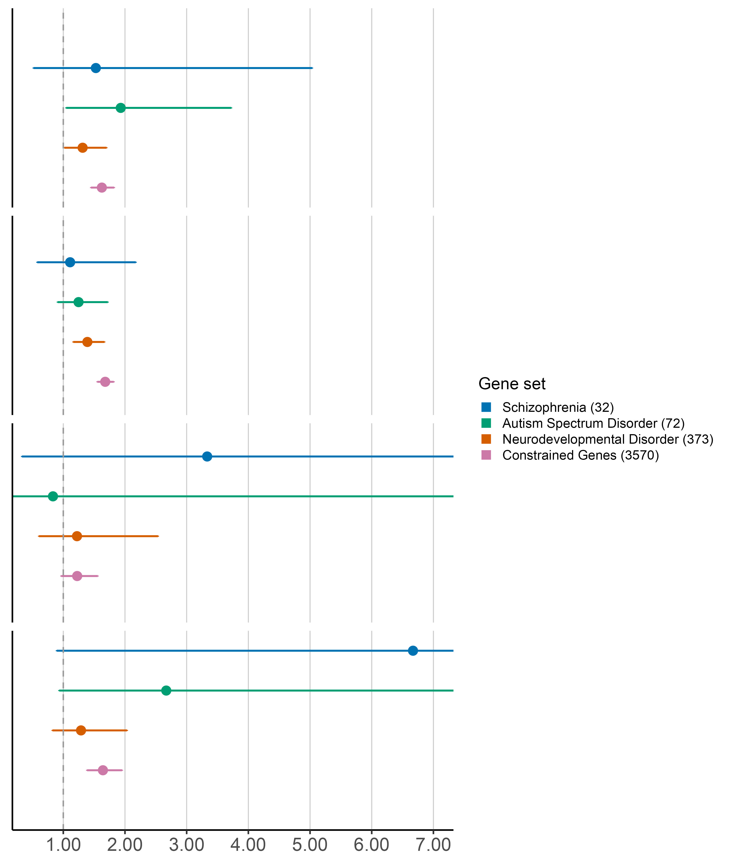
Promoter
Exon 1
Intron
Exon 2
Intron
Exon 3
Intron
Exon 4
5’ UTR
CDS
Deletion SVs recapitulate exonic SNV enrichment and detect additional intronic enrichment
Deletion SVs
Exonic deletion SVs recapitulate coding SNV enrichment
Exonic
Odds ratio (95% CI)
Notes:
And so, again, using all of our favorite gene sets from before, we see positive enrichment across the board, all of which is comparable to what we’ve just seen within the coding space with protein truncating variants.
We’re seeing a similar positive enrichment as with PTVs across schizophrenia, autism, and neurodevelopmental gene sets.
And a nice enrichment in constrained genes that mimics what we saw with SNVs of around 1.6 (in pink), in line with our expectations.
Again, these serve as an excellent positive control and we’re seeing signal pretty much exactly where we would expect.
(a breakpoint in an exon)

Slide 21
Our deletion class of interest
Intronic
Deletion
Promoter
Exon 1
Intron
Exon 2
Intron
Exon 3
Intron
Exon 4
5’ UTR
CDS
Notes:
Next, improving upon and going beyond our previous coding SNV analysis, by dipping our toes into some noncoding regions, we can look at intronic deletions, which are events that only span intronic regions

Slide 22
Promoter
Exon 1
Intron
Exon 2
Intron
Exon 3
Intron
Exon 4
5’ UTR
CDS
Deletion SVs recapitulate exonic SNV enrichment and detect additional intronic enrichment
Deletion SVs
Intronic deletion SVs detect additional intronic enrichment
Intronic
Odds ratio (95% CI)
Notes:
And what we’re starting to pick up on is this additional signal, which gives us confidence in the viability of using SVs beyond the coding space.
Here, we’re able to see a similar pattern of enrichment among each of our gene sets of interest.
And again, I want to draw special attention to the constrained gene signal that has an OR hovering above 1.6

Slide 23
Our deletion class of interest
Promoter
Deletion
Promoter
Exon 1
Intron
Exon 2
Intron
Exon 3
Intron
Exon 4
5’ UTR
CDS
Notes:
For this last portion, I’m going to continue with the thread of looking at some of these noncoding regions.
Particularly, since the entire noncoding space is difficult to understand, the promoter seems to be another sensible, and importantly, interpretable place to start.
So, we’ll be looking at deletions that overlap the predicted promoter region, but doesn’t overlap the transcript.
Promoter region inferred from the GTF window upstream of the TSS

Slide 24
Promoter
Exon 1
Intron
Exon 2
Intron
Exon 3
Intron
Exon 4
Deletion SVs affecting promoter and 5’ UTR regions show a strong positive enrichment in constrained genes and schizophrenia-associated genes
5’ UTR
CDS
Deletion SVs affecting promoter regions suggest a positive enrichment in constrained and schizophrenia-associated genes
Deletion SVs
Promoter
Odds ratio (95% CI)
Notes:
In this case, what we see is that, once again, there’s a positive enrichment in constrained genes, as expected for these rare deletions
Promoter region inferred from the GTF window upstream of the TSS

Slide 25
Promoter
Exon 1
Intron
Exon 2
Intron
Exon 3
Intron
Exon 4
Deletion SVs affecting promoter and 5’ UTR regions show a strong positive enrichment in constrained genes and schizophrenia-associated genes
5’ UTR
CDS
Deletion SVs affecting promoter regions suggest a positive enrichment in constrained and schizophrenia-associated genes
Deletion SVs
Promoter
Odds ratio (95% CI)
Notes:
There is also this strong point estimate for SCZ associated genes
And just to foreshadow, this will be similar to what we see with 5’ UTR deletions
Promoter region inferred from the GTF window upstream of the TSS

Slide 26
Our deletion class of interest
5’ UTR
Deletion
Promoter
Exon 1
Intron
Exon 2
Intron
Exon 3
Intron
Exon 4
5’ UTR
CDS
Notes:
So speaking of, lastly we’ll look at 5’UTR deletions as events that have at least one breakpoint in the 5’UTR region.
Once again, this type of deletion is a good place to start due to the more direct and straightforward interpretability of what exactly these disruptions could be affecting

Slide 27
Promoter
Exon 1
Intron
Exon 2
Intron
Exon 3
Intron
Exon 4
Deletion SVs affecting promoter and 5’ UTR regions show a strong positive enrichment in constrained genes and schizophrenia-associated genes
5’ UTR
CDS
Deletion SVs affecting
5’ UTR regions suggest a positive enrichment in constrained and schizophrenia-associated genes
Deletion SVs
5’ UTR
Odds ratio (95% CI)
Notes:
So once again, we’re able to see these strong point estimates in constrained and SCZ associated genes (5:2 in SCZ).
[which could in turn disrupt the TSS or a have a similar effect on the promoter inhibiting transcription]]

Slide 28
Deletion SVs
Deletion SVs affecting promoter and 5’ UTR regions show a strong positive enrichment in constrained genes and schizophrenia-associated genes
Promoter
Deletion SVs affecting promoter and 5’ UTR regions show a strong positive enrichment in constrained and schizophrenia-associated genes
5’ UTR
Odds ratio (95% CI)
Notes:
So putting these two sets of results next to each other (the promoters that we just looked at on top, and the 5’UTRs on the bottom), it’s clear that the stronger effects that we see might indicate that noncoding structural variation, particularly those affecting these regions, could be a useful indicator for teasing out which genes are important for SCZ risk.

Slide 29
Deletion SVs
Deletion SVs affecting promoter and 5’ UTR regions show a strong positive enrichment in constrained genes and schizophrenia-associated genes
Promoter
Deletion SVs affecting promoter and 5’ UTR regions show a strong positive enrichment in constrained and schizophrenia-associated genes
Incorporating SVs may help improve gene discovery
5’ UTR
Odds ratio (95% CI)
Notes:
Running with this idea, it might be reasonable to incorporate SVs to help improve gene discovery.

Slide 30
Genes affected by 5’ UTR deletions are among previously identified, significant schizophrenia-associated genes
SRRM2 ANKRD12
KDM6B EIF2S3
MAGI2
Notes:
As a simple proof of concept, and to make this idea a little bit more concrete, in our datasets, we find these 5 genes that are affected by these rare 5’UTR deletions.

Slide 31
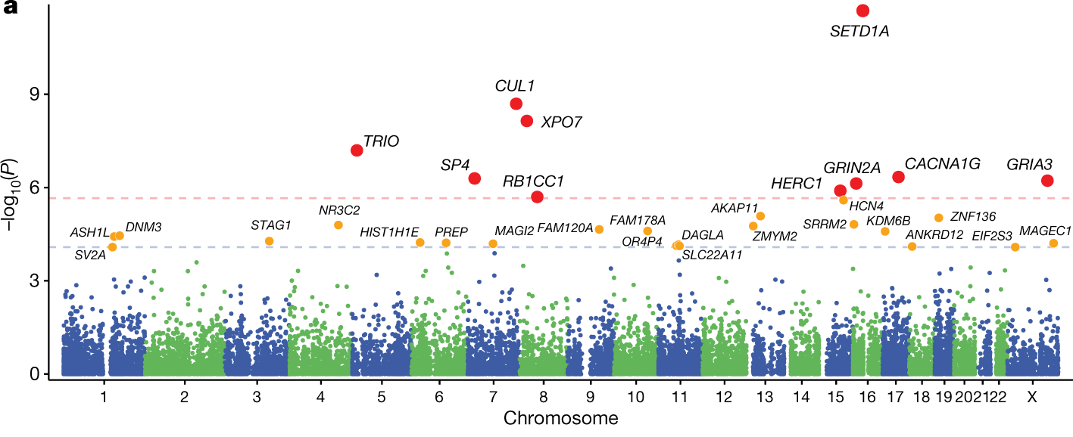
Genes affected by 5’ UTR deletions are among previously identified, significant schizophrenia-associated genes
SRRM2 ANKRD12
KDM6B EIF2S3
MAGI2
Notes:
Looking for these in the previous SCHEMA analysis of schizophrenia exomes, we find that these genes are also among those determined to be FDR significant.
However, had these 5’ UTR deletion SVs been called, annotated, and added to the previous SCHEMA analysis in the same way that they have been for the WGSPD cohort, these genes could have been pushed up and reclassified to exome wide significance.

Slide 32
Noncoding Constrained Regions
Noncoding
SNV
There is no significant enrichment of SNVs, but significant enrichment of SVs in noncoding constrained regions
Deletion
SV
Duplication
SV
Odds ratio (95% CI)
Notes:
Finally, I just wanted to bring back this result that I originally used to motivate the value of using rare SVs over SNVs, particularly when we want to look at noncoding signal, and tie everything together to highlight the direction that we’re hoping to continue building toward.
I think that this result really encapsulates and tells a story of how important SVs are and, in the larger picture, how important WGS is.
Whereas SNVs weren’t able to detect any clear positive enrichment of constraint in noncoding regions, deletion and duplication SVs show a very different picture – with these point estimates hovering around 2.
Of course, we’re only able to appreciate this result because of the resolution and scope provided by WGS when it comes to detecting these types of events
And lastly, I’ve only briefly teased this noncoding duplication signal, but there’s certainly a lot more to be uncovered from really refining and digging into these duplication events as well as other sv classes.
Also look into insertion events such as with ALU, L1, and SVA mobile element insertion events

Slide 33
Conclusions
Noncoding SNVs are not as biologically interpretable
SVs can help identify noncoding constrained regions associated with neuropsychiatric disorders
SVs affecting noncoding regions, such as the promoter and UTR, may contribute towards disease risk
Incorporating SVs may help improve gene discovery
Notes:
And with that, some final takeaways.
We’ve shown that noncoding SNVs are far less biologically interpretable compared to SVs
In particular, SVs can be used to help identify noncoding constrained regions associated with neuropsychiatric disorders
And in this case, we’ve shown an example in which SVs affecting promoters and UTRs could contribute towards schizophrenia risk
All in all, we’ve made a case for the integration and the benefits of SVs in gene discovery

Slide 34

Acknowledgements
Talkowski Lab:
Mike Talkowski
Cal Liao
Jack Fu
Chelsea Lowther
Xuefang Zhao
Neale Lab:
Benjamin Neale
Cal Liao
Patrick Schultz
Siwei Chen
Dan Howrigan
Sinéad Chapman
Caroline Cusick
Sam Bryant
WGSPD consortium collaborators:
Michael Boehnke – University of Michigan
Nelson Freimer – University of California, Los Angeles
Stacey Gabriel – Broad Institute of MIT and Harvard
Sarah Gagliano – University of Michigan
Guilio Genovese – Broad Institute of MIT and Harvard
David Glahn – Boston Children’s Hospital
James Knowles – SUNY Downstate Medical Center
Steven McCarroll – Harvard University
Hyun Min Kang – University of Michigan
Roel Ophoff – University of California, Los Angeles
Aarno Palotie – University of Helsinki
Duncan Palmer – Broad Institute of MIT and Harvard
Carlos Pato – SUNY Downstate Medical Center
Michele Pato – SUNY Downstate Medical Center
Laura Scott – University of Michigan
Sponsors:
Stanley Foundation
BD2
Dalio Foundation
Dauten Family
NIMH
Notes:
So to end, I'd like to give a huge thank you to Cal, Ben, and Mike for their mentorship. As well as to our sponsors, all of the collaborators and folks involved with the WGSPD consortium. and of course, all of you for your attention. Thank you.

Slide 36
Gnocchi is well calibrated to assess SV constraint
Chen et al. (2024)
Notes:
To further motivate the use of Gnocchi, here’s a plot showing that Gnocchi is well calibrated against structural variation (SV) constraint in addition to SNVs
So this plot shows Gnocchi scores along the x-axis, where we get more constrained the further right look
And along the y-axis is the APS (or adjusted proportion of singletons) score, which is a constraint metric developed for SVs, where larger values indicate higher constraint
And so we can see that among the most constrained Gnocchi regions, we’re also expecting SV constraint

Slide 37
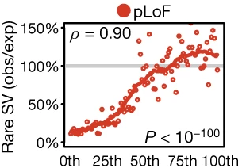
There is a strong concordance between rare deletion SVs and existing SNV constraint metrics.
pLoF SNV constraint (LOEUF) percentile
Collins et al. (2020) Nature
Notes:
One thing that I want to quickly highlight and provide some more motivation for, that we’ll see in the upcoming results, is our continued interest in and use of the constrained gene set while looking at SVs
In particular, we’re expecting and hoping to see a concordance between rare deletion SVs and constraint, which is really motivated by the previous work summarized in this plot.
What we’re seeing is that among the most constrained genes (towards the left side of the plot), we see a pretty clear depletion of deletions compared to what we see in some of the less constrained genes (on the right side of the plot).
Expectation of deletions based on gene length, genomic context, and structure of exons and introns

Slide 38
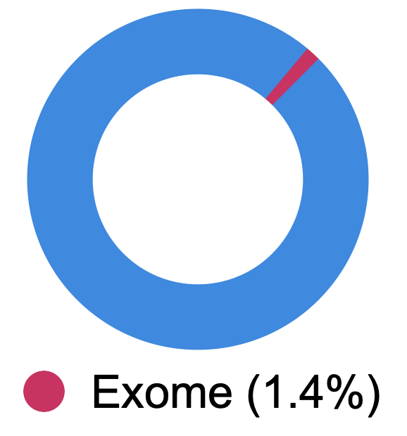
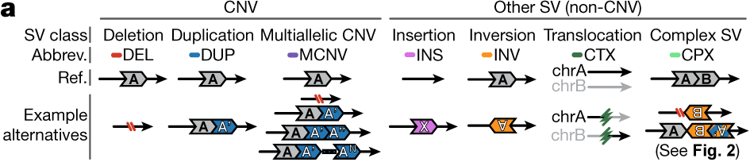
Advantages of SV calling in WGS
Human genome
Genome-wide coverage
Ability to capture full range of SV types
10,000x more SVs detected per genome
Collins, R.L., Brand, H., Karczewski, K.J. et al. (2020) Nature
Slide courtesy of Emma Pierce-Hoffman
Notes:
The advantages of resolution and scope that comes with WGS compared to WES naturally lend themselves well to characterizing Structural variation (SVs) across the genome in both coding and noncoding regions.
Not only that, whereas WES is only able to capture copy number variants (or CNVs), which include DEL, DUP, and MCNVs, WGS is able to capture other SVs in addition to CNVs. To include insertions, inversion, translocations, and other complex SV.
Together, this allows WGS to detect 10,000 times more SVs per genome than with WES
SV: genomic rearrangement of > 50 NT
Important contributor to human disease

Slide 39


SV discovery with GATK-SV
SV callers
Joint genotyping
Manta
MELT
Wham
cn.MOPS
Clustering
GATK-gCNV
Complex event resolution
Evidence types
Paired end
Split read
Filtering
Read depth
B-Allele frequency
Collins et al., Nature (2020)
Functional annotation
Notes:
Without going into too much detail, SVs were called and annotated using the GATK-SV pipeline

Slide 40
Characterization of SV sizes in WGSPD
Notes:
All of the previous benefits of WGS for SVs becomes a little more concrete here
Looking at the distribution of sizes across all SV types (different colors), we see that we have the resolution to confidently detect a range of SVs (sizes along the x axis) and these fall within expectations
Also look into insertion events such as with ALU, L1, and SVA mobile element insertion events

Slide 41
Characterization of SV counts in gnomAD v4
Count of SVs per Genome
by population
Notes:
And finally, here’s the distribution of SVs detected stratified by inferred ancestry. It should be clear from the varying number of observations across ancestries that accounting for these diverse populations is extremely important for any similar analyses moving forward.

